Slide 1

Evaluating the Performance of Object Detection Models for Accurate Sri Lankan Traffic Sign Detection
Learner Name: MN. Sihanas
Student Id: 1030371
Course & Batch: HND in Computing - 22
Assessor: Mrs. ALF. Sajeetha
Supervisor: Mrs. NF. Mafaza
Notes:
“Good morning, everyone. My name is Sihanas, and today I’m going to present my progress on evaluating the performance of object detection models for accurate Sri Lankan traffic sign detection.”

Slide 2
Table of Contents
Introduction.
Research background.
Problem statement.
Research question.
Methodology.
Top level architecture.
Literature Review.
Model Evaluation.
Dataset brief.
Gantt Chart.
Cost.
Conclusion.
Acknowledgement.
Table of Contents
Notes:
“Here’s the table of contents for my presentation today.”

Slide 3

Introduction.
Notes:
Let me give you a small introduction about this study.

Slide 4

Introduction
Importance of traffic sign detection in AI and computer vision.
Relevance to Sri Lankan road systems.
Comparing YOLOv8, Faster R-CNN, and SSD using mAP and F1-Score.
Notes:
“Traffic sign detection is very important for autonomous vehicles. This helps roads safety and guides drivers in real time. This study focuses on comparing object detection models — YOLOv8, Faster R-CNN, and SSD — to see which performs best for detecting Sri Lankan road signs.”

Slide 5
Research Background.
Notes:
Let see the background of this research.

Slide 6
Research background
Rising significance of autonomous vehicles and driver assistance systems
Reliable traffic sign detection is a key requirement for road safety and autonomous driving
The performance of object detection models varies under different conditions, especially in real-world scenarios
Few comparative studies exist focusing on their performance with Sri Lankan road signs
This study aims to fill that gap by evaluating YOLOv8, Faster R-CNN, and SSD for their accuracy in detecting Sri Lankan traffic signs
Notes:
“The main concern is that there are many object detection models, but their performance varies under different conditions, especially with real-world data. Few studies have been done to compare their accuracy on Sri Lankan road signs. Existing researches are limited to general dataset and not region specific. This is a gap we want to fill in this study.”

Slide 7
Problem Statement.
Notes:
Now let’s focus on the problem statement.

Slide 8
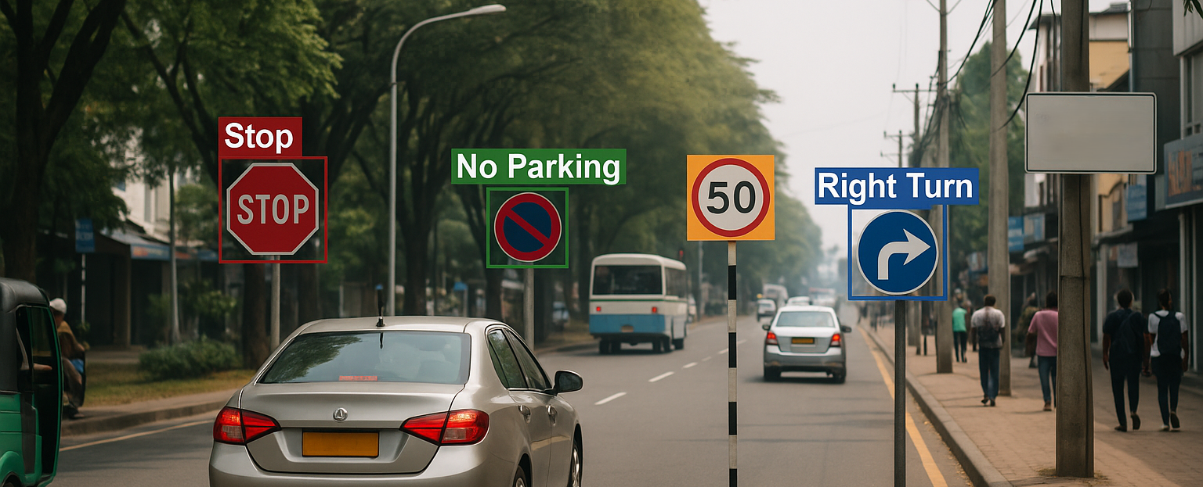
Traffic sign detection is crucial for autonomous vehicles and road safety.
Currently, object detection models show varying performance under different conditions.
There’s a lack of comparative studies evaluating their accuracy on Sri Lankan road signs.
This inconsistency poses a challenge for developing reliable autonomous vehicle technologies.
This study aims to compare and identify the most accurate and efficient model for Sri Lankan conditions.
Notes:
“There’s a lack of comparative studies evaluating the accuracy of object detection models on Sri Lankan road signs. This inconsistency makes it hard to choose a reliable algorithm for autonomous vehicles. So this study aims to identify which performs most accurately in our context.”

Slide 9
Research
Question

Slide 10
Research Question
Research Question: Which object detection model (YOLOv8, Faster R-CNN, or SSD) achieves the highest accuracy in detecting Sri Lankan traffic signs, as measured by mean Average Precision (mAP) and F1-Score?
Hypothesis: Among the YOLOv8, Faster R-CNN and SSD, one of the object detection models will achieve the highest mAP in detecting Sri Lankan traffic signs, with performance variations due to differences in model architecture and detection capabilities.
Dependent Variables: Mean Average Precision (mAP) (the accuracy of the models), F1-Score.
Independent Variable: The object detection model used (YOLOv8, Faster R-CNN, SSD).
Notes:
The key research question driving this study is: Which object detection model among the three, achieves the highest accuracy in detecting Sri Lankan traffic signs, as measured by mean Average Precision, and f1 score?
The hypothesis will be: Among the YOLOv8, Faster R-CNN and SSD, one of the object detection models will achieve the highest mAP and f1 score in detecting Sri Lankan traffic signs, with performance variations due to differences in model architecture and detection capabilities.
In this study meanAveragePrecision and F1-Score will be the dependant variables and independent variable are going to be the selected models.

Slide 11
Methodology

Slide 12
Research Design: Quantitative research.
Data Collection Method: Secondary dataset (Sri Lankan traffic sign dataset).
Evaluation Approach: Analyze the performance of YOLOv8, Faster R-CNN, and SSD. Use mean Average Precision (mAP) and F1-Score as the key evaluation metric.
Comparison & Analysis: Compare the models based on mAP and F1 scores. Identify the most effective model for Sri Lankan traffic sign detection.
Notes:
For this study I’m using the the quantitative research design, as our focus is on measuring numerical performance values.
The data collection method involves using a secondary dataset. Which was already collected and properly labeled.
To assess these models, we will analyze the performance using mean Average Precision and f1 score, which is a widely used metrics for these kind of task.
Finally, we will compare the models based on their mAP scores and analyze the results to identify the most effective model

Slide 13
Top level architecture

Slide 14
Literature Review
Research Planning & Proposal
Preliminary Study
Dataset (Sri Lankan Traffic Sign)
Preprocessing.
(annotating (TXT, VOC))
Model Inference (YOLOv8, Faster R-CNN, SSD)
Best Model Selection
Comparison & Analysis
Evaluation (mAP & F1-Score)
Report & Documentation
Notes:
The research design is going to be like this.
Do some preliminary study then planning the research, then do some literature reviews.
Then we will collect and pre process the dataset. Then we will let each models to identify the objects.
After that we will evaluate their performance, then we will compare & analyze the results to find the best model.
Finally we will prepare our report and documentation.

Slide 15
Literature Review
Notes:
“We reviewed related studies to understand their methods and results. This helps us identify gaps and guides our own approach. I'll briefly go over the main points from these papers.”

Slide 16
Paper: Performance Comparison of Object Detection Models for Road Sign Detection Under Different Conditions (Fatima et al., 2024)
Context & Aim
Compare state-of-the-art detectors (YOLOv8, YOLOv9, RTMDet, Faster R‑CNN, RetinaNet) under varied environmental and operational conditions in road sign detection.
Methodology
Fine-tuned models on large-scale datasets.
Evaluated using metrics: mean Average Precision (mAP), frames-per-second (FPS), and model loss.
Included additional training enhancements: data augmentation and hyperparameter tuning.
Results
YOLOv8 and YOLOv9 achieved highest real-time detection rates.
RTMDet offered the best trade-off between speed and accuracy.
Faster R‑CNN and RetinaNet delivered higher precision but were slower.
Research Gap
Analysis conducted on general (non-region-specific) datasets.
Lacks focused evaluation on the unique characteristics of Sri Lankan traffic signs.
Notes:
“This study compared state-of-the-art detectors under different conditions. It found that YOLOv8 and YOLOv9 performed the best in real time, while RTMDet was a balance of speed and accuracy. However, their evaluation was not done with a region-specific dataset, which is a gap we aim to fill.”

Slide 17
Paper: A Traffic‑Sign Detection Algorithm Based on Improved Sparse R‑CNN (Cao et al., 2021)
Context & Aim
Enhance Sparse R‑CNN for improved detection of traffic signs by optimizing the backbone and attention mechanisms.
Methodology
Added Res2Nest backbone and Dynamic Instance Interactive Head (DIIH) for richer multi-scale feature representation.
Evaluated on standard TT100K traffic sign dataset.
Results
Improved mAP and robustness for small sign detection.
Backbone enhancements and attention modules enabled more accurate region proposals.
Research Gap
Higher computational cost may limit real-time applicability.
Evaluations not performed on datasets representative of Sri Lankan road signs.
Notes:
“This paper improved Sparse R-CNN by adding Res2Nest and DIIH modules. This resulted in higher mAP and robustness — especially for small signs. However, their method comes with higher computational cost and it was not evaluated with a Sri Lankan dataset.”

Slide 18
Paper: Evaluating and Benchmarking Object Detection Models for Traffic Sign Detection (Mishra et al., 2022)
Context & Aim
Benchmark a variety of object detection models (Faster R‑CNN, YOLOv3, SSD, RetinaNet, CenterNet, Cascade R‑CNN) using multiple traffic sign datasets.
Methodology
Employed precision, recall, and mAP across TT100K and GTSD datasets.
Comparative analysis under diverse real-world conditions including occlusion and small object detection challenges.
Results
CenterNet and Cascade R‑CNN achieved highest overall accuracy, especially for small signs.
Faster R‑CNN and YOLOv3 showed strong baseline performance but were slightly behind top performers.
Research Gap
Performance degrades in adverse weather and occlusion scenarios.
No testing on Sri Lankan traffic sign dataset; regional generalization remains untested.
Notes:
“This study evaluated a range of detectors. CenterNet and Cascade R-CNN performed well, especially with small signals, while Faster R-CNN and YOLOv3 fell slightly behind. However, their evaluation was not performed under adverse conditions or with a country-specific dataset.”

Slide 19
Dataset in brief

Slide 20
The dataset used in this study was sourced from Roboflow, a publicly available repository of labelled image datasets for object detection.
It comprises 5,404 images in total, divided into training, validation, and testing sets.
The dataset includes 37 classes of Sri Lankan road signs, encompassing a range of regulatory, warning, and informational signals frequently encountered by drivers.
Annotations for each image are provided in VOC and TXT formats, following standard object detection practices with bounding boxes to aid algorithm training and evaluation.
Notes:
“Our dataset comes from Roboflow. It includes 5,404 images divided into training, validation, and testing sets. We have 37 classes of road signs in total. Annotations are provided in VOC and TXT format, following standard practices. The images show different lighting conditions and perspectives.”

Slide 21
Model Evaluation
Notes:
I have made a dry test on the selected models,

Slide 22
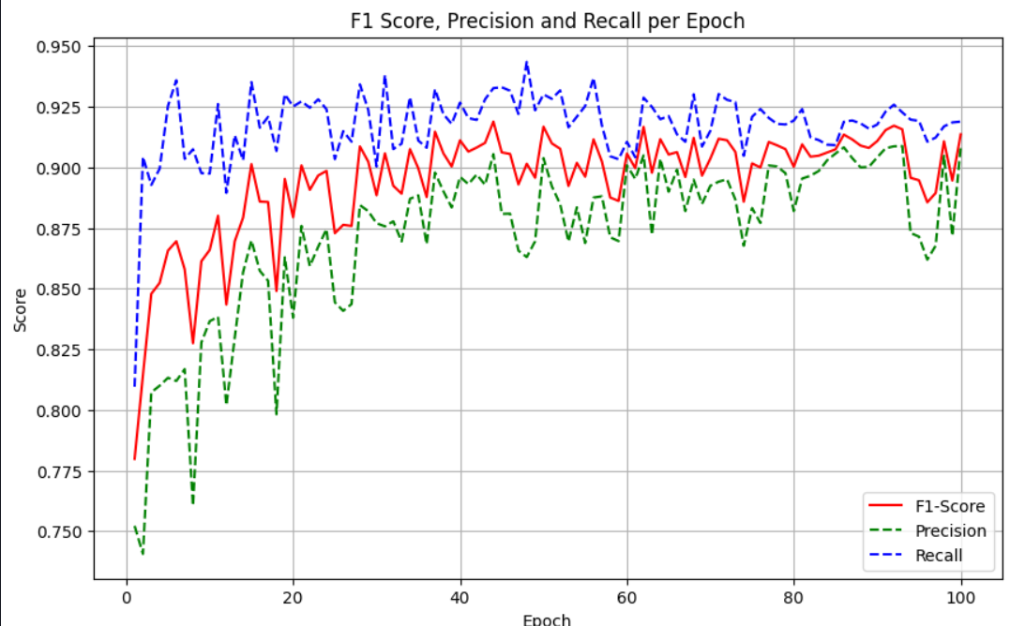
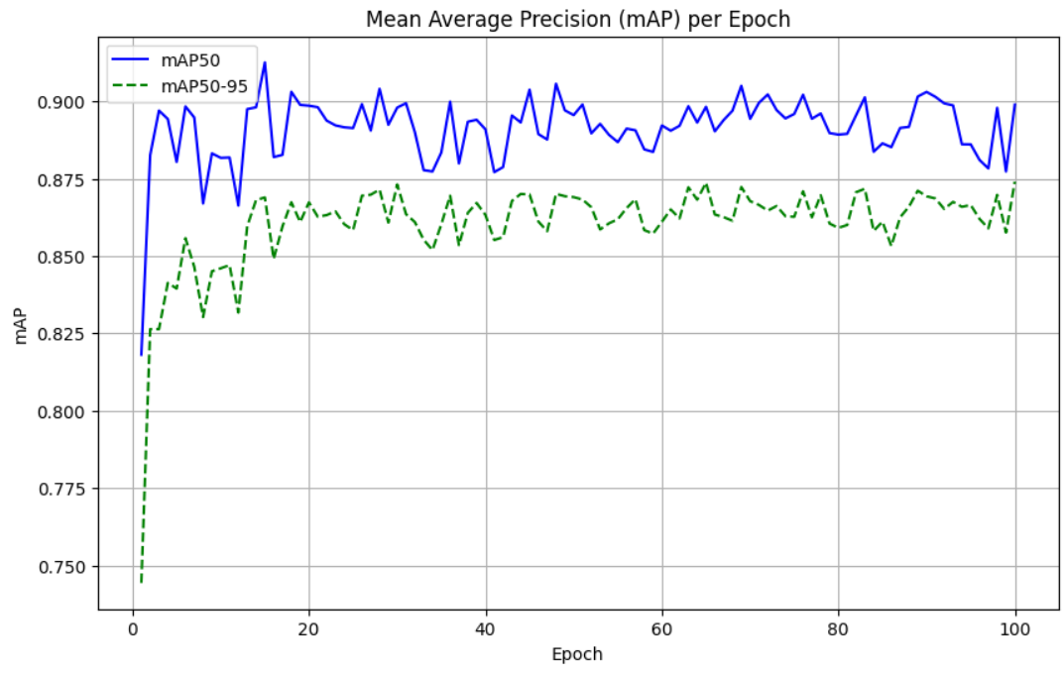
YOLOv8
Notes:
yolov8

Slide 23
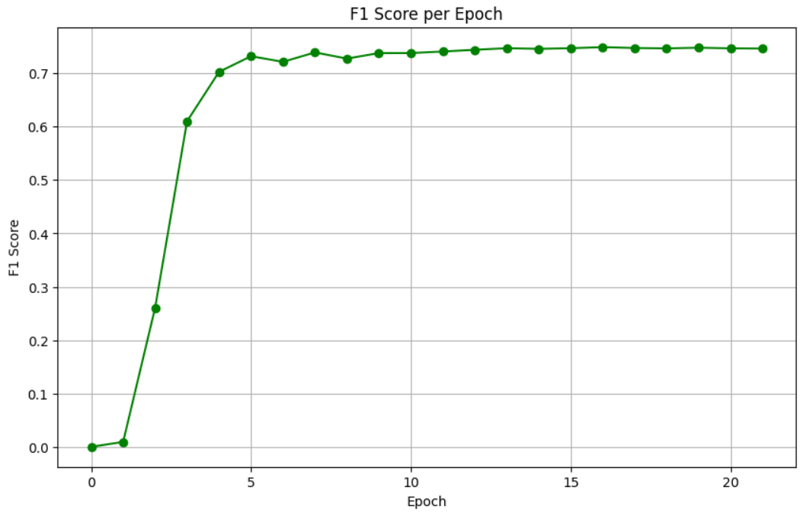
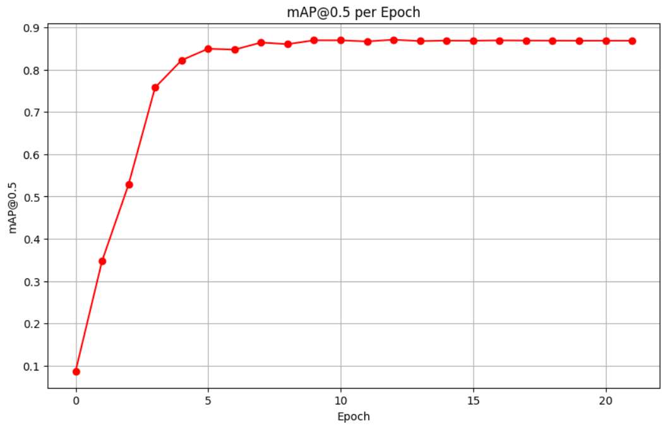
SSD 300

Slide 24
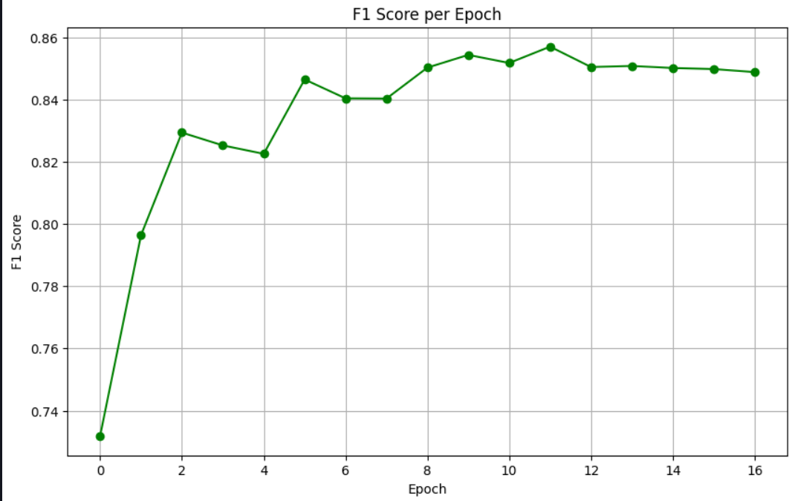
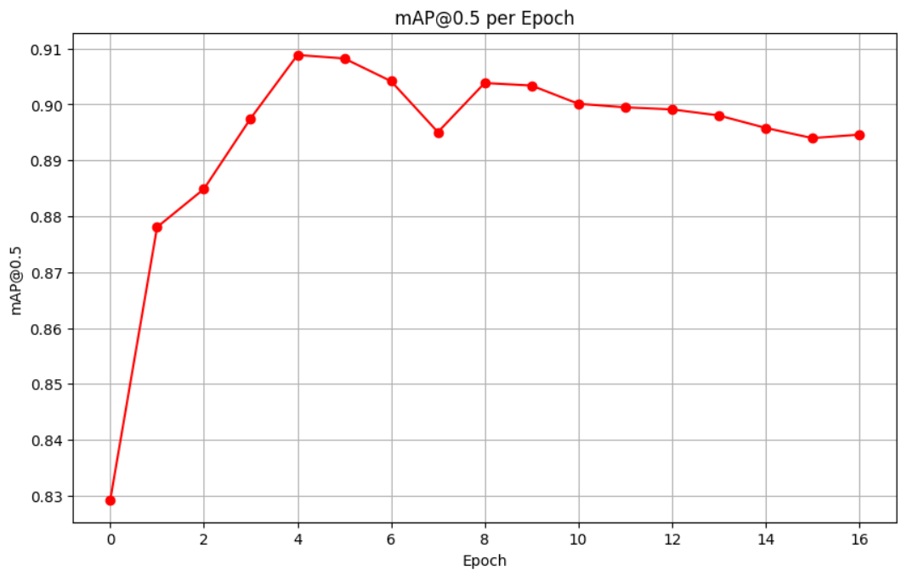
Faster R-CNN VGG16

Slide 25
Gantt Chart

Slide 26
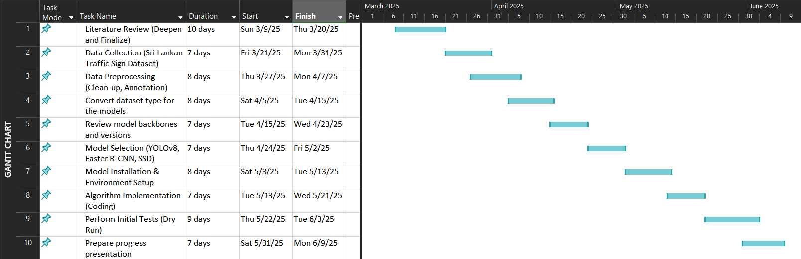
Notes:
“This Gantt chart shows our progress and scheduled activities from proposal presentation. So far, we've finished the literature review, data collection, and data preparation. Currently, we are setting up our models and ready to evaluate their performance.”

Slide 27
Conclusion

Slide 28
Conclusion
The study evaluates YOLOv8, Faster R-CNN, and SSD for Sri Lankan traffic sign detection.
mAP (mean Average Precision) and F1-Score is used to measure model performance.
The research identifies the most accurate model for Sri Lankan road conditions.
Findings contribute to AI-driven traffic systems and autonomous vehicles.
Helps improve road safety and smart transportation solutions in Sri Lanka.
Notes:
Ultimately, this research provides valuable insights into the selection of the most suitable object detection model for real-world traffic sign detection in Sri Lanka, paving the way for future advancements in AI-based traffic monitoring and intelligent transportation systems.

Slide 29
Reference

Slide 30
Fatima, Z. T. M. M. H. V. R. R. T. a. R. R., 2024. Performance Comparison of Object Detection Models for Road Sign Detection Under Different Conditions. International Journal of Advanced Computer Science and Applications, 15(12).)
(Jinghao Cao, J. Z. X. J., 2021. A Traffic-Sign Detection Algorithm Based on Improved Sparse R-cnn. IEEE Access.)
(Mishra, A. K. A. M. S. A. K. Z. J. S. S. a. T. A., 2022. Evaluating and Bench-marking Object Detection Models for Traffic Sign and Traffic Light Datasets, s.l.: Computer Vision Foundation.)
Notes:
“Here are the main references I used in this study.”

Slide 31

Acknowledgement
Thanks To,
Supervisor: Ms. NF. Mafaza.
Assessor: Ms. ALF. Sajeetha.
Coordinator: Mr. MIM. Nismy.
Eng. AL. Jubailah.
BCAS Campus Kalmunai.
Notes:
Before concluding, I would like to express my sincere gratitude to Mrs. NF. Mafaza, my supervisor for their valuable guidance. And the assessor Mrs. ALF. Sajeetha and the coordinator MR. MIM. Nismy, and Engineer Jubailah miss for being here. And the BCAS Campus.
Additionally, I acknowledge the work of previous previous researchers.

Slide 32

Thank you
Notes:
Thank you all for your time and attention!

Slide 33

Questions?
Notes:
If you have any questions, I would be happy to answer. Thankyou.

